Slide 1
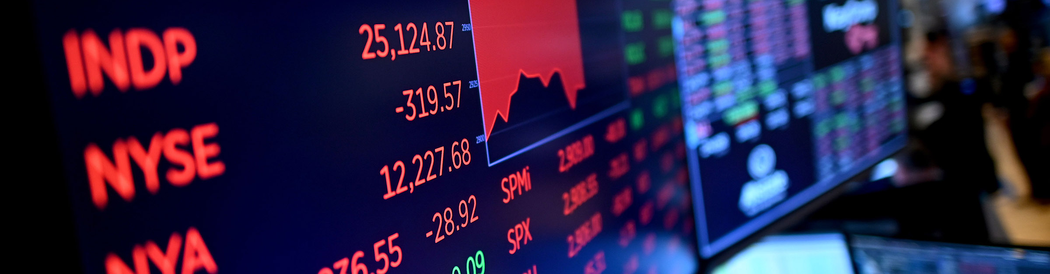

Hedge Fund X: Financial Modeling Challenge
Final ML Project
STA 9891 UMA Machine Learning for Data Mining
December 13, 2021 Prof. Kamiar Rahnama Rad
Group 1: Michael S. Bonetti
https://github.com/mbonetti-nyc/Hedge-Fund-X
1

Slide 2



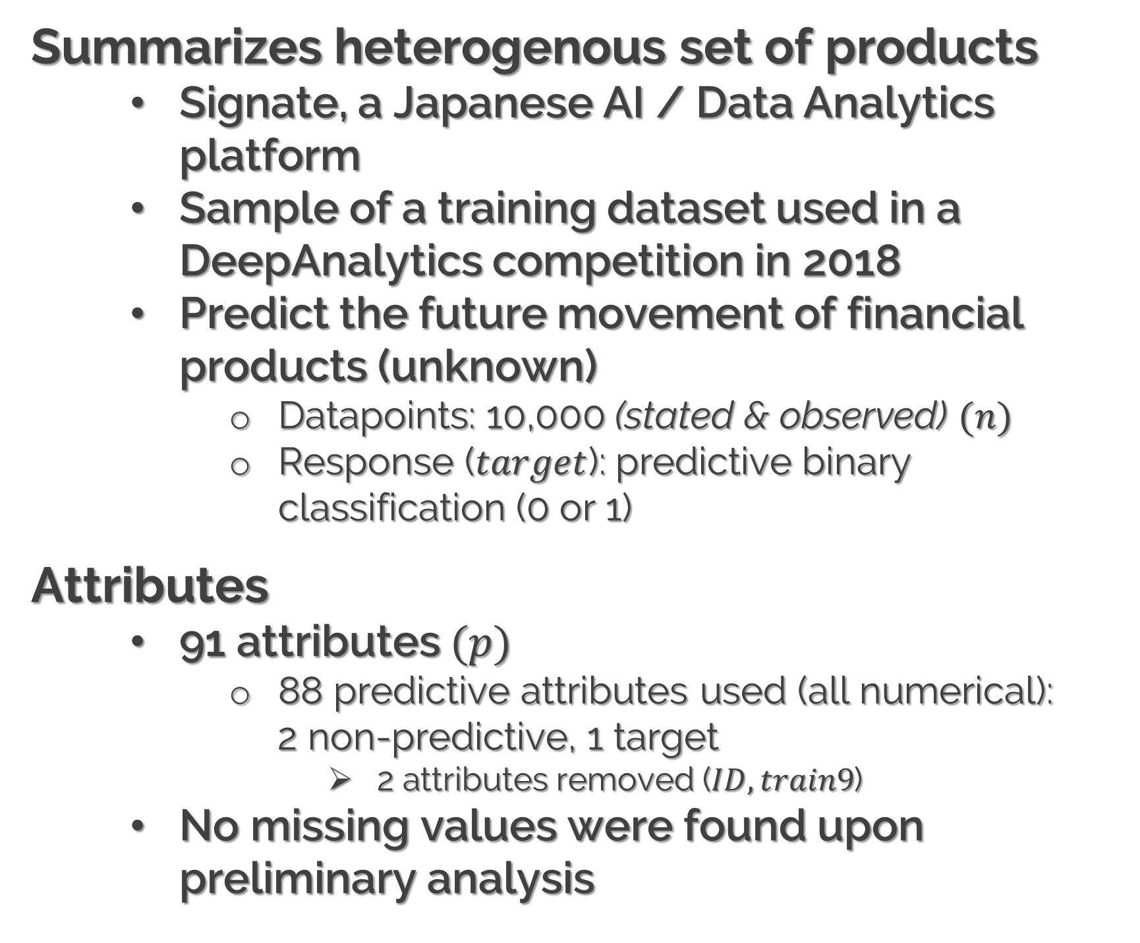
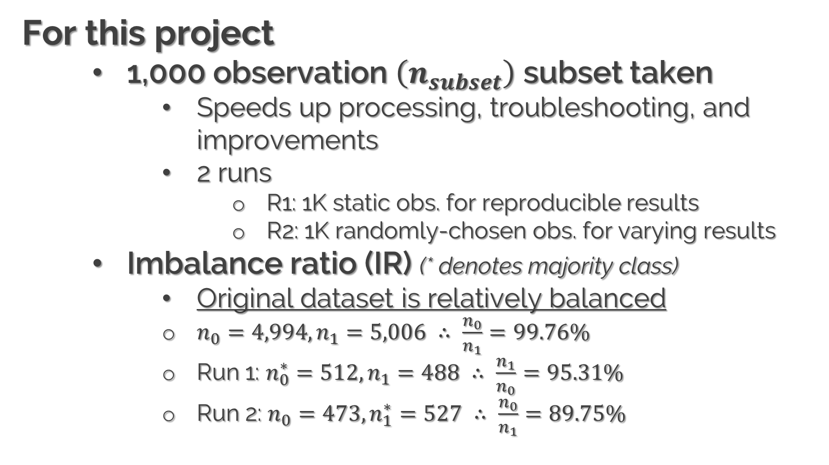
01
BRIEF DESCRIPTION
HEDGE FUND X | SIGNATE COMPETITION ON KAGGLE
About this dataset
Summarizes heterogenous set of products
Signate, a Japanese AI / Data Analytics platform
Sample of a training dataset used in a DeepAnalytics competition in 2018
Predict the future movement of financial products (unknown)
Datapoints: 10,000 (stated & observed) $(n)$
Response ($target$): predictive binary classification (0 or 1)
Attributes
91 attributes $(p)$
88 predictive attributes used (all numerical):
2 non-predictive, 1 target
2 attributes removed ($ID, train9$)
No missing values were found upon preliminary analysis
For this project
1,000 observation $\left(n_{subset}\right)$ subset taken
Speeds up processing, troubleshooting, and improvements
2 runs
R1: 1K static obs. for reproducible results
R2: 1K randomly-chosen obs. for varying results
Imbalance ratio (IR) (* denotes majority class)
Original dataset is relatively balanced
$n_{0}=4,994, n_{1}=5,006 ∴ \frac{n_{0}}{n_{1}}=99.76\%$
Run 1: $n_{0}^{∗}=512, n_{1}=488 ∴ \frac{n_{1}}{n_{0}}=95.31\%$
Run 2: $n_{0}=473, n_{1}^{∗}=527 ∴ \frac{n_{0}}{n_{1}}=89.75\%$
2

Slide 3
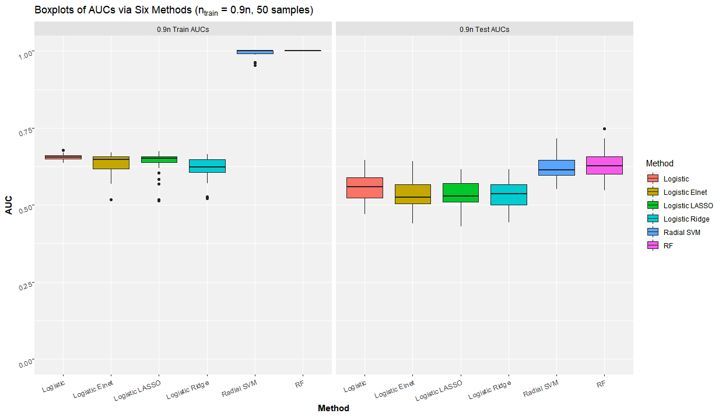

02
BOXPLOTS
(0.9$n$) | AUCs via 6 ML METHODS
3

Slide 4
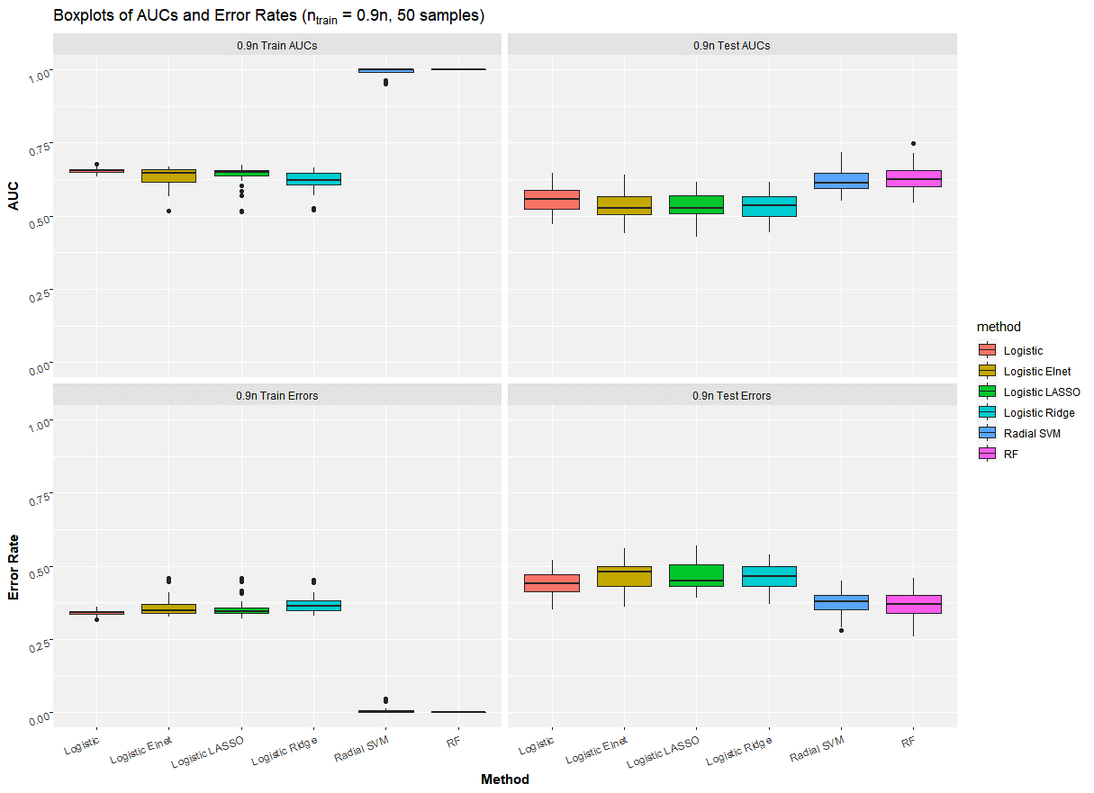

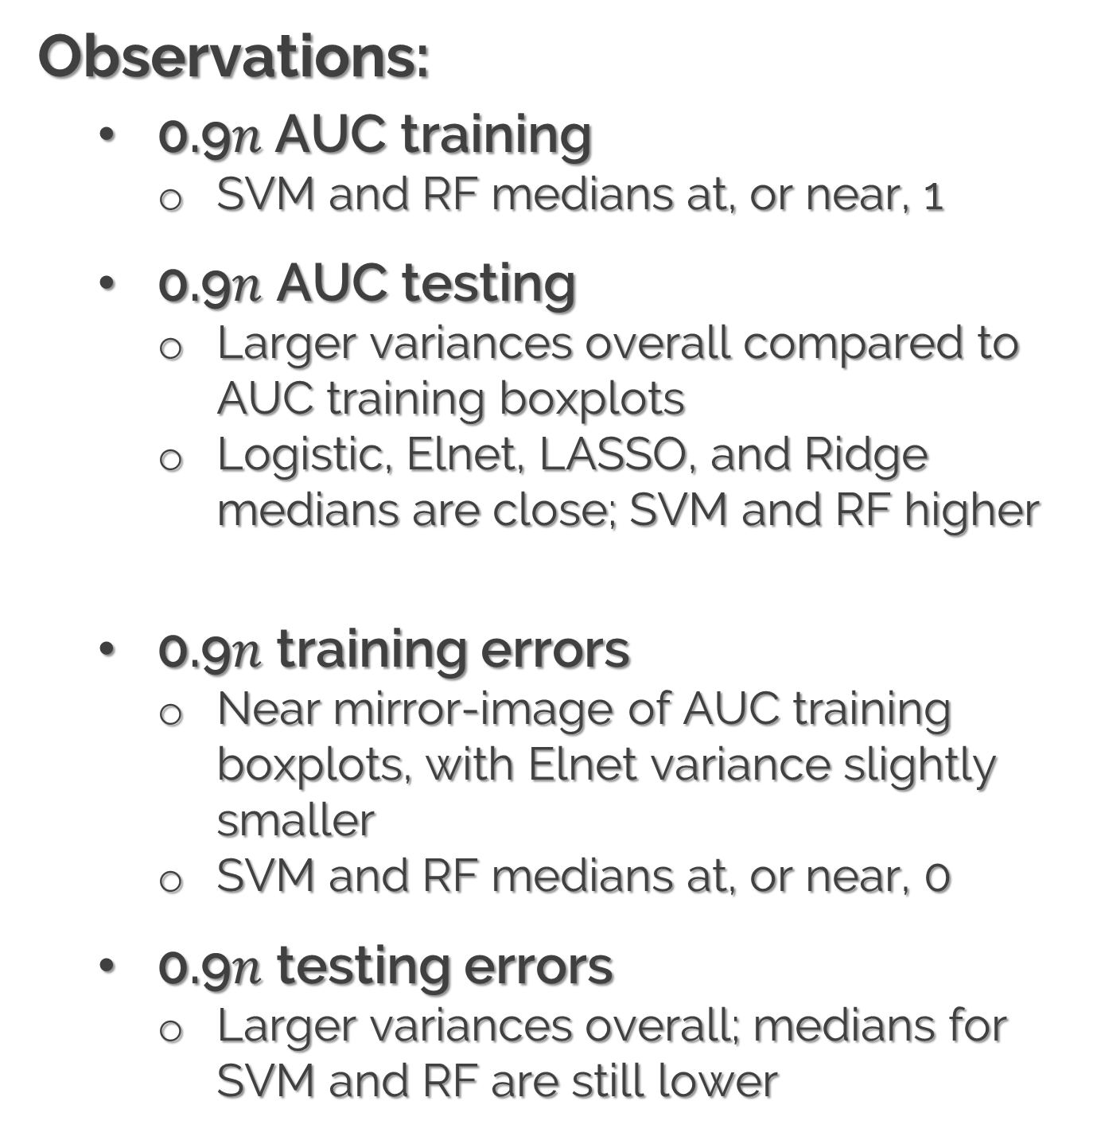
02
BOXPLOTS
(0.9$n$) | AUCs & ERROR RATES via 6 ML METHODS
Observations:
0.9$n$AUC training
SVM and RF medians at, or near, 1
0.9$n$ AUC testing
Larger variances overall compared to AUC training boxplots
Logistic, Elnet, LASSO, and Ridge medians are close; SVM and RF higher
0.9$n$ training errors
Near mirror-image of AUC training boxplots, with Elnet variance slightly smaller
SVM and RF medians at, or near, 0
0.9$n$ testing errors
Larger variances overall; medians for SVM and RF are still lower
4

Slide 5
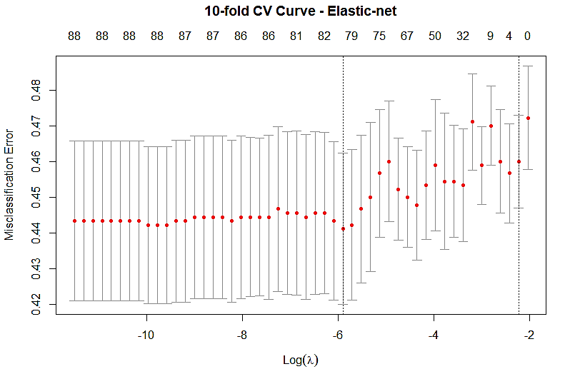
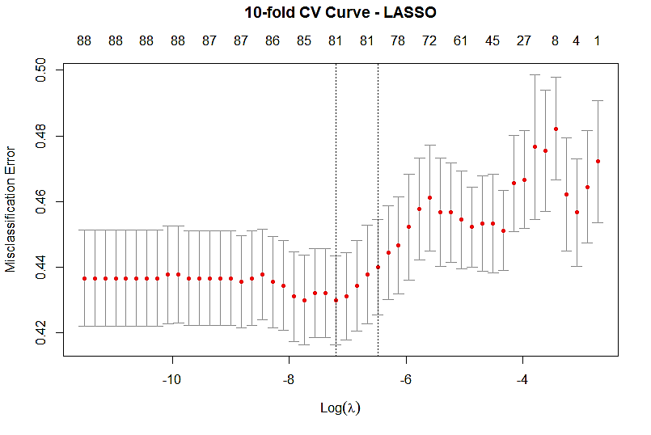
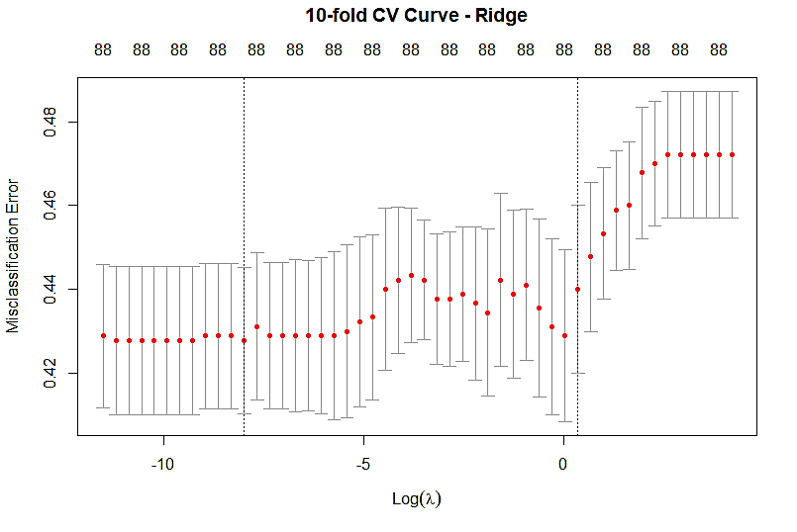

03
CV CURVES
10-fold (0.9$n$) | ELASTIC-NET, LASSO, & RIDGE
EN Run 1: 0.910 secs.
EN Run 2: 0.780 secs.
LASSO Run 1: 0.910 secs.
LASSO Run 2: 0.830 secs.
Ridge Run 1: 0.860 secs.
Ridge Run 2: 0.780 secs.
Run 1: Using static 1,000 observation subset
Run 2: Using 1,000 randomly-selected observation subset
All CV plots were generated from Run 2
5

Slide 6
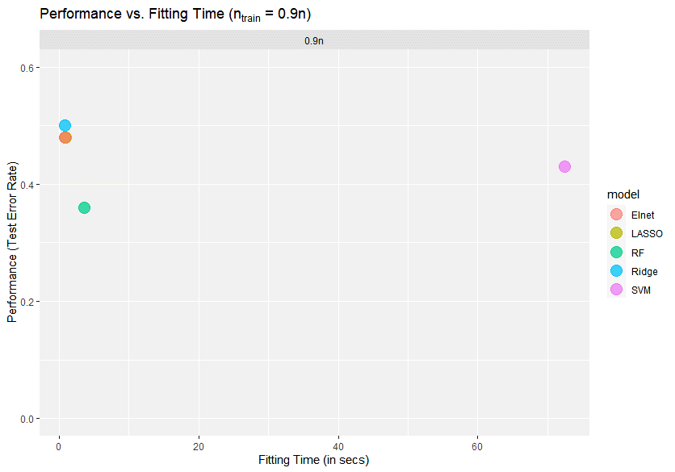
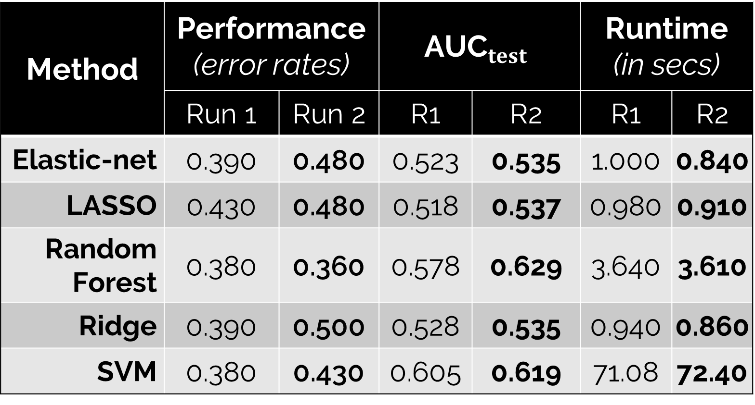
04
PERFORMANCE vs. RUNTIME
Method | Performance (error rates) |  | $${\text{AUC}}_{test}$$ |  | Runtime (in secs)
 | Run 1 | Run 2 | R1 | R2 | R1 | R2
Elastic-net | 0.390 | 0.480 | 0.523 | 0.535 | 1.000 | 0.840
LASSO | 0.430 | 0.480 | 0.518 | 0.537 | 0.980 | 0.910
Random Forest | 0.380 | 0.360 | 0.578 | 0.629 | 3.640 | 3.610
Ridge | 0.390 | 0.500 | 0.528 | 0.535 | 0.940 | 0.860
SVM | 0.380 | 0.430 | 0.605 | 0.619 | 71.08 | 72.40
Observations:
Avg. Performance: 0.422
Fast runtimes
However, the AUCs are no better than 50 / 50
Trade-off? Slightly.
RF consistently performed the best, albeit with a runtime of +3.50 secs.
SVM takes the longest, with minimal performance improvement
6

Slide 7
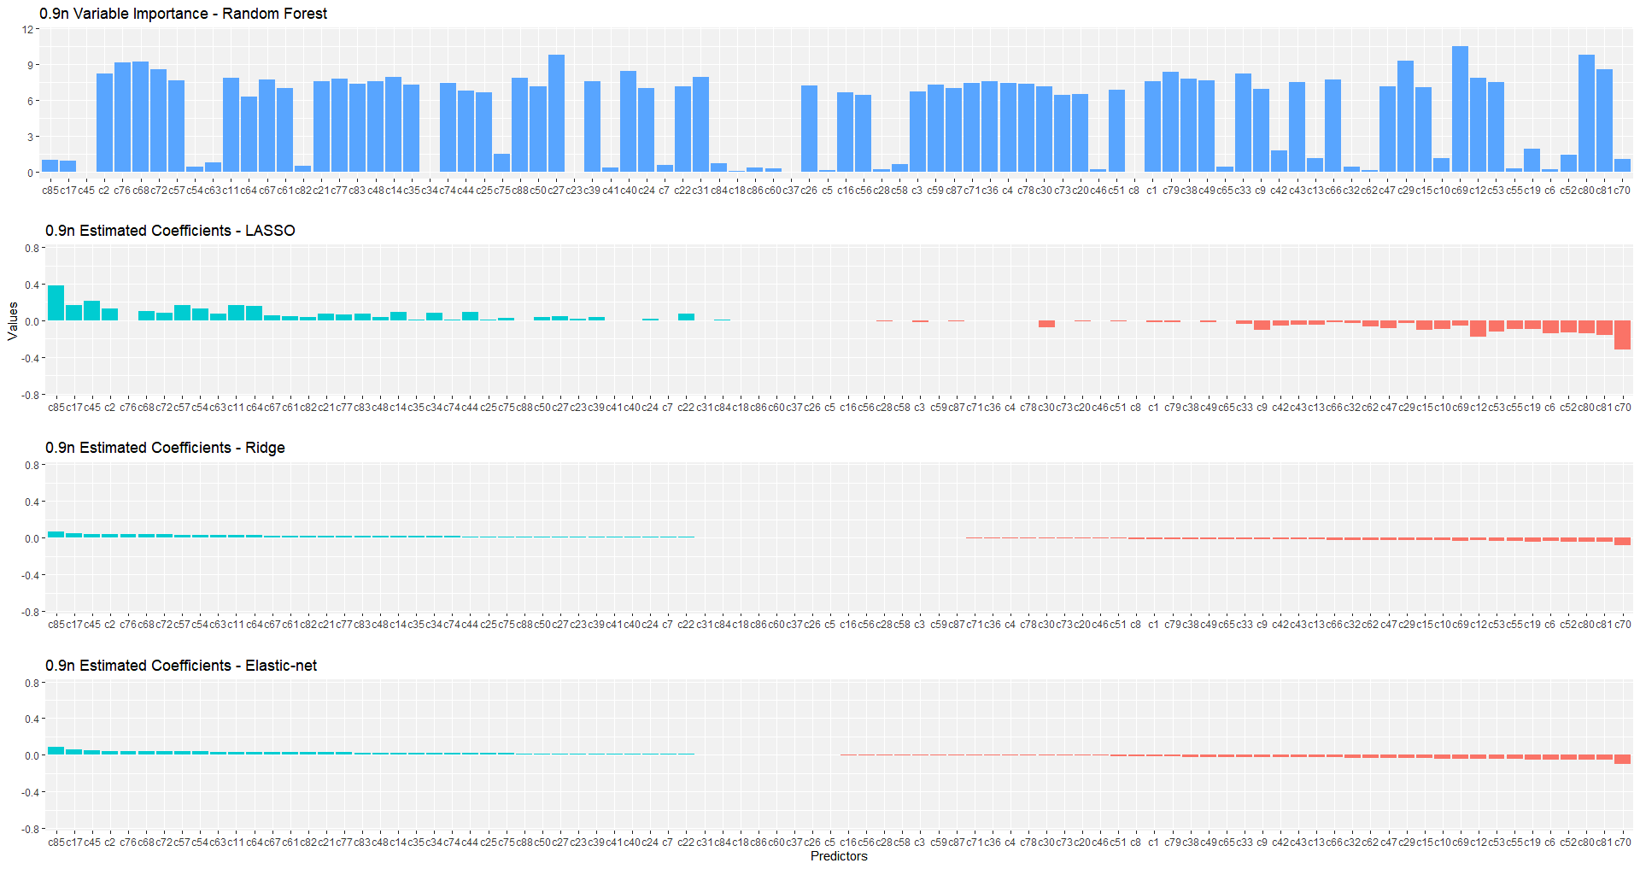
05
VARIABLE IMPORTANCE
7

Slide 8
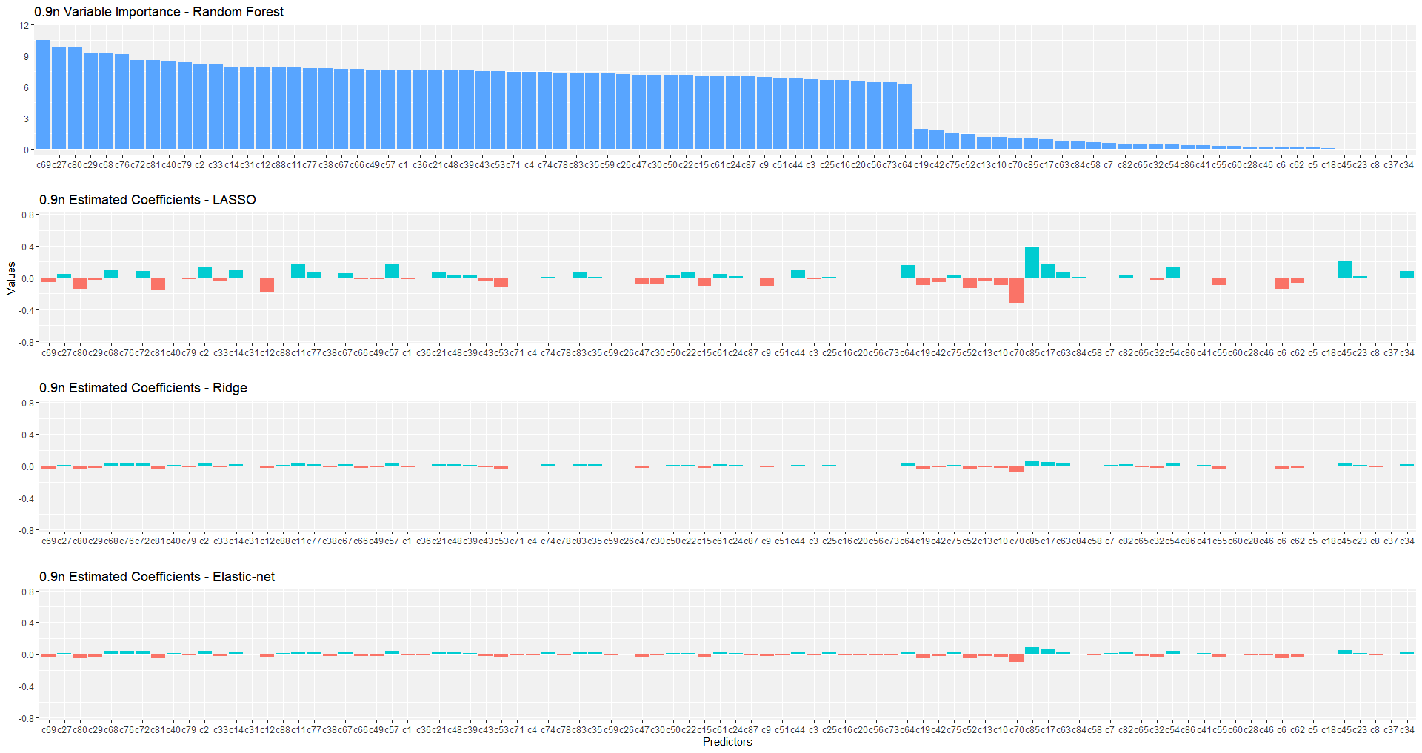
05
VARIABLE IMPORTANCE
8

Slide 9
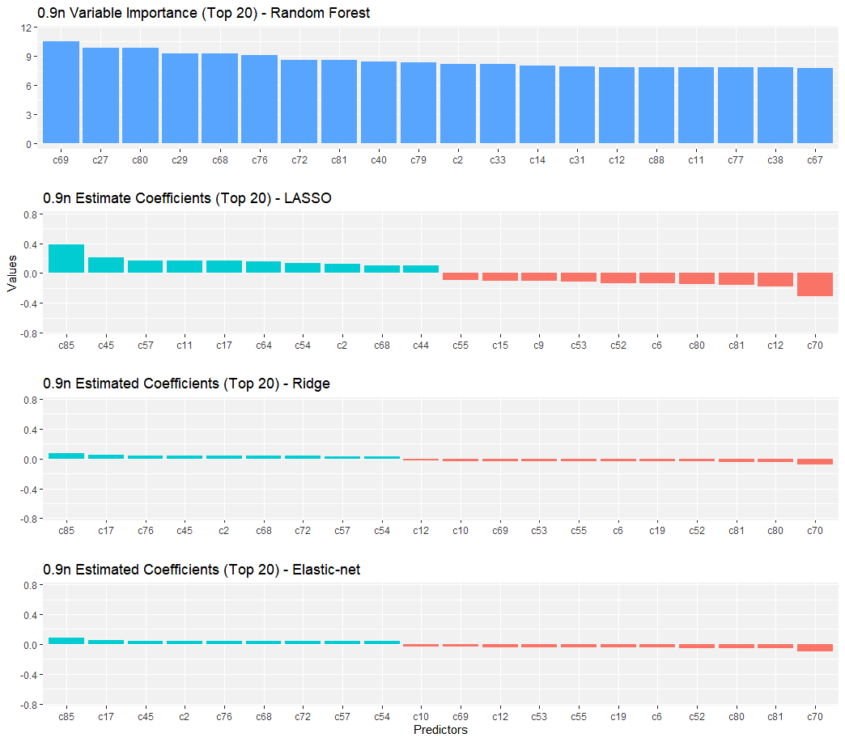
06
CLOSING REMARKS
HEDGE FUND X | SIGNATE COMPETITION ON KAGGLE
Variable Importance (Top 3)
Positive influence
c85, c17, c45
Negative influence
c70, c81, c80
However, …
Too many unknowns
Cannot tell which specific funds / stocks affected performance
No better than a coin toss
Except for RF and SVM, AUCs are no better than 50 / 50
Improvements can be made…
RF & SVM (best performers), AdaBoost, SGD, kNN, NB
… but the financial market is unpredictable!
Therefore, this makes financial modeling decidedly more difficult to perform
9

Slide 10
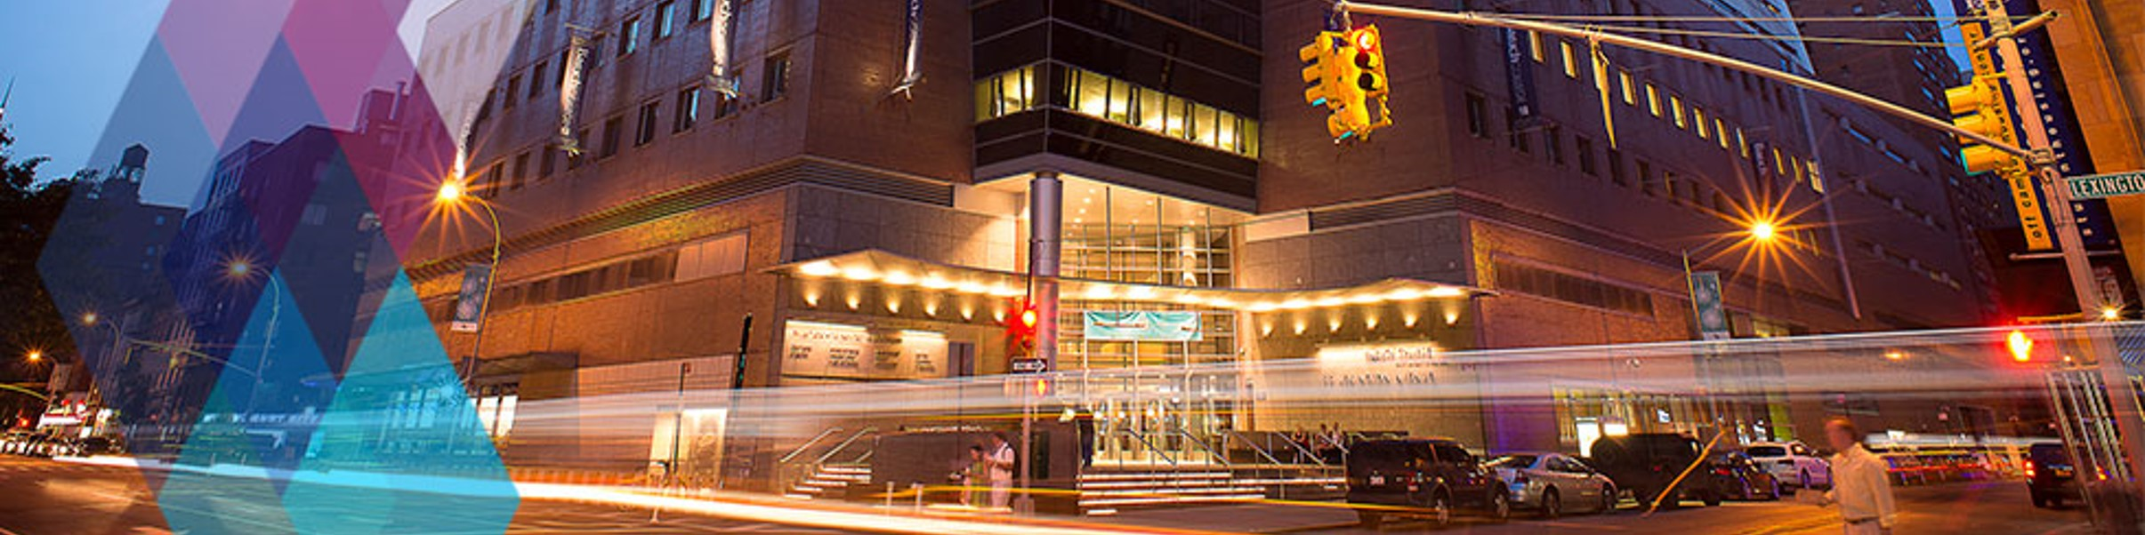
Escadaria Selarón – Santa Teresa, RJ
THANK YOU!
Q&A
https://github.com/mbonetti-nyc/Hedge-Fund-X
10

